Slide 1

Fundamental Concepts in Machine Learning Model Training (1)
Professor Bo Liu
James Watt School of Engineering

Slide 2
Supervised learning flow
Features
Training
Model
Circle
Square
Labels
Prediction
Square
Circle
Triangle
Test Data
Training Data
What happens in training?

Slide 3
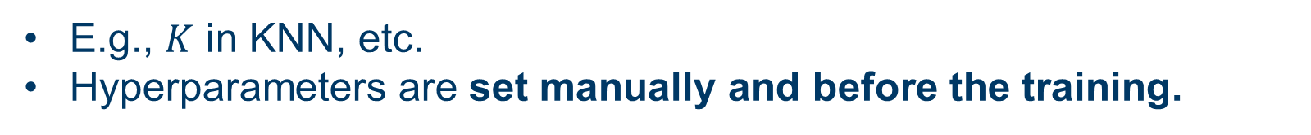
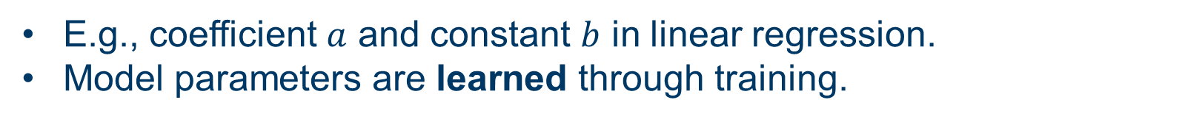
Hyperparameters vs. model parameters
Hyperparameters are pre-set parameters whose values are used to control the learning process.
E.g., $K$ in KNN, etc.
Hyperparameters are set manually and before the training.
Model parameters are configuration variables that are internal to the model and whose values are estimated from data.
E.g., coefficient $a$ and constant $b$ in linear regression.
Model parameters are learned through training.

Slide 4
Loss function
Loss function is a function that evaluates the difference between the actual output and the predicted output of the model.
The value calculated by the loss function is called “loss.”
There are various kinds of loss functions:
  Mean squared error
  Mean absolute error
  Categorical cross entropy
  …

Slide 5
Model training
Model training is to find the optimal values for the model parameters to minimize the loss.
To train a model:
First, define a loss function.
Then, minimize the loss function.
Obtain the optimal model parameters.
Train a model
Minimize a function

Slide 6
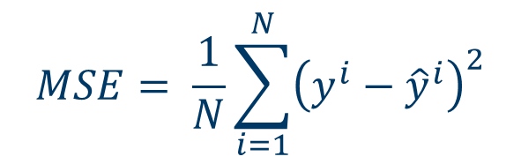
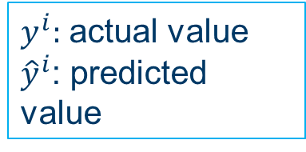
Loss functions in regression: MSE
1. Mean squared error (MSE)
$$MSE= \frac{1}{N}\sum_{i=1}^{N}{{\left(y^{i}−{\hat{y}}^{i}\right)}^{2}}$$
$y^{i}:$ actual value
${\hat{y}}^{i}$: predicted value
MSE is always convex and differentiable → easy to optimize.
MSE is not robust to outliers.
Outlier: data points that are noticeably different from the rest.
outliers

Slide 7
Loss functions in regression: MSE
outliers
MSE is not robust to outliers
If the k-th sample is an outlier, the difference ${(y^{i}−\hat{y}}^{k})$ will be large.
The loss will be dominated by outliers since ${(y^{i}−\hat{y}}^{k})$ is squared in MSE.

Slide 8
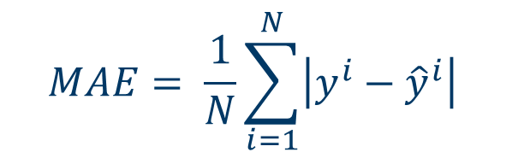
Loss functions in regression: MAE
2. Mean absolute error (MAE)
$$MAE= \frac{1}{N}\sum_{i=1}^{N}{\left|y^{i}−{\hat{y}}^{i}\right|}$$
MAE is more robust to outliers (why?).
But it is not differentiable, which makes it hard to optimize.
outliers

Slide 9
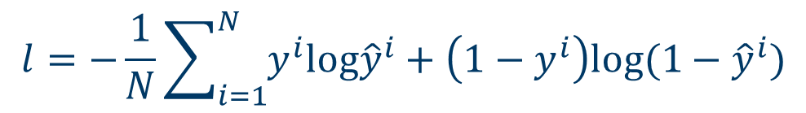
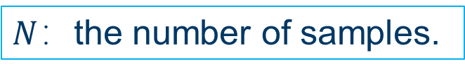
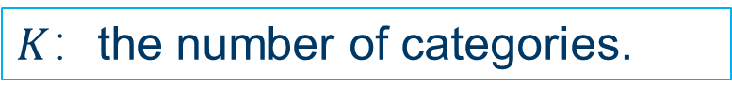
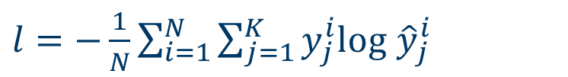
Loss functions in classification
1. Binary cross entropy
Binary cross entropy is applied when the number of categories is 2.
$$l=−\frac{1}{N}\sum_{i=1}^{N}{y^{i}log{\hat{y}}^{i}+\left(1−y^{i}\right)log(1−{\hat{y}}^{i})}$$
$N$：the number of samples.
2. Categorical cross entropy
Categorical cross entropy is used for multiclass classification.
$l=−\frac{1}{N}\sum_{i=1}^{N}{\sum_{j=1}^{K}{y_{j}^{i}log⁡}}$ ${\hat{y}}_{j}^{i}$
$K$：the number of categories.
Cross entropy is differentiable (easier to optimize).
However, it has multiple local minima.

Slide 10




Thanks!
#UofGWorldChangers
@UofGlasgow

